Slide 1

Welcome to our class
Vu Xuan Thieu Primary School
Teacher: Nguyen Thi Thuy

Slide 2

GAME: LUCKY BALLS
1
2
3
4
5
6
7
8
9
10

Slide 3
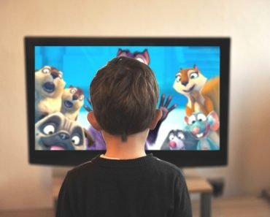
Ball 1
A: What’s he doing ?
B: He’s watching a video
OPEN
BACK

Slide 4
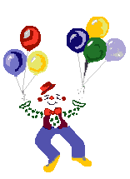
Ball 2
LUCKY BALL
OPEN
BACK

Slide 5

Ball 3
A: What’s she doing ?
B: she’s listening to music
OPEN
BACK

Slide 6
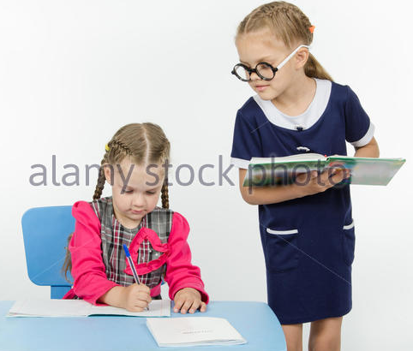
Ball 4
A: What’s she doing ?
B: she’s writing a dictation
OPEN
BACK

Slide 7
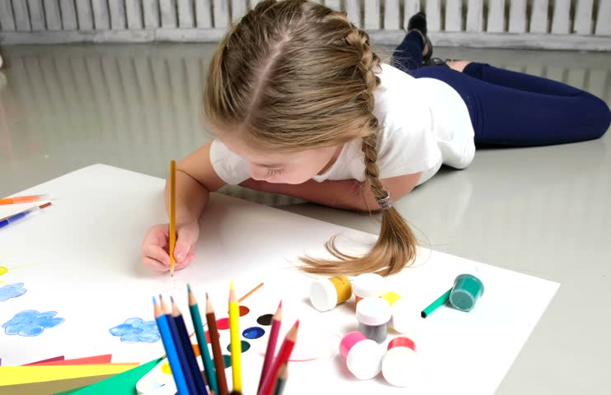
Ball 5
A: What’s she doing ?
B: She’s drawing
OPEN
BACK

Slide 8
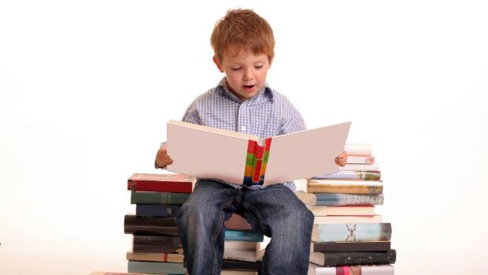
Ball 6
A: What’s he doing ?
B: He’s reading a text.
OPEN
BACK

Slide 9

Ball 7
LUCKY BALL
OPEN
BACK

Slide 10
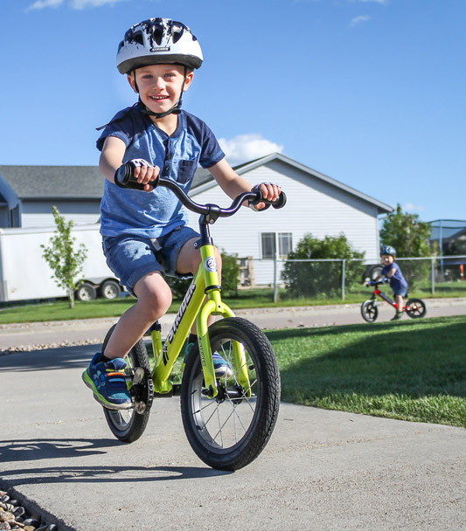
Ball 8
A: What’s he doing ?
B: He’s riding a bike
OPEN
BACK

Slide 11
Ball 9
LUCKY BALL
OPEN
BACK

Slide 12

Ball 10
A: What’s she doing ?
B: She’s dancing.
OPEN
BACK

Slide 13


Tuesday, December 4th 2018
Unit 9:What are they doing ?
Lesson 2:1,2,3,4

Slide 14
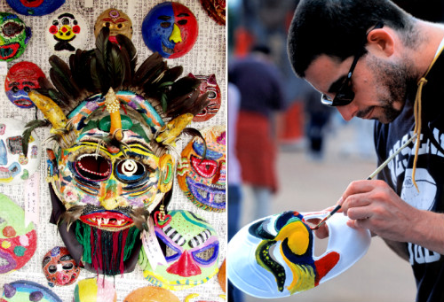
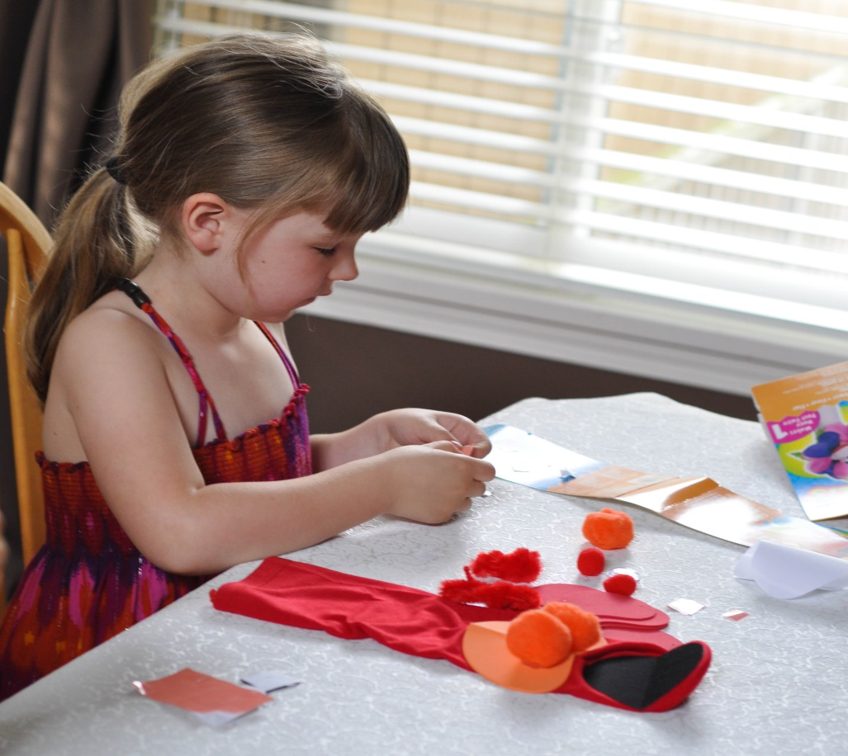
1.New words
painting masks
making a pupet

Slide 15
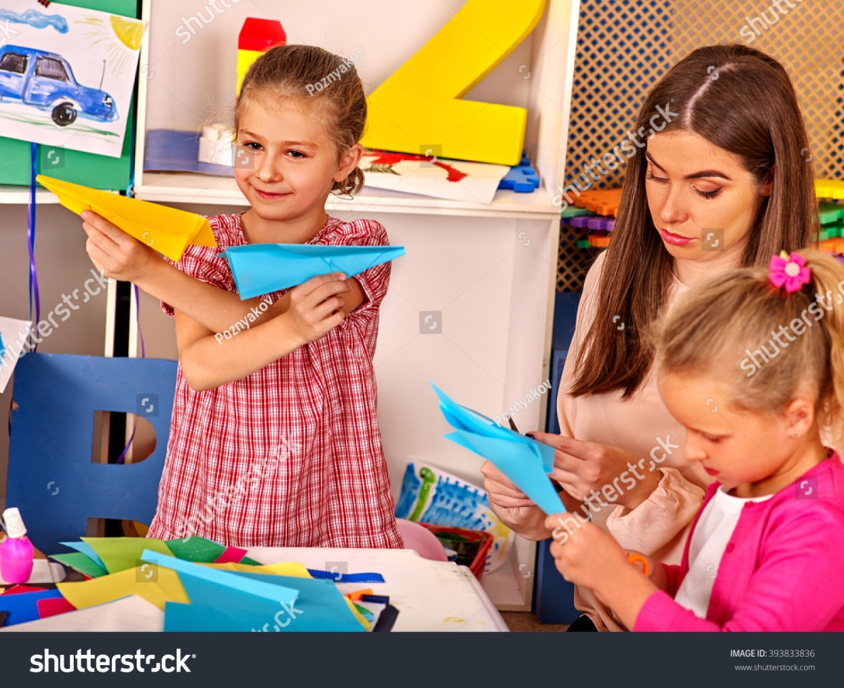
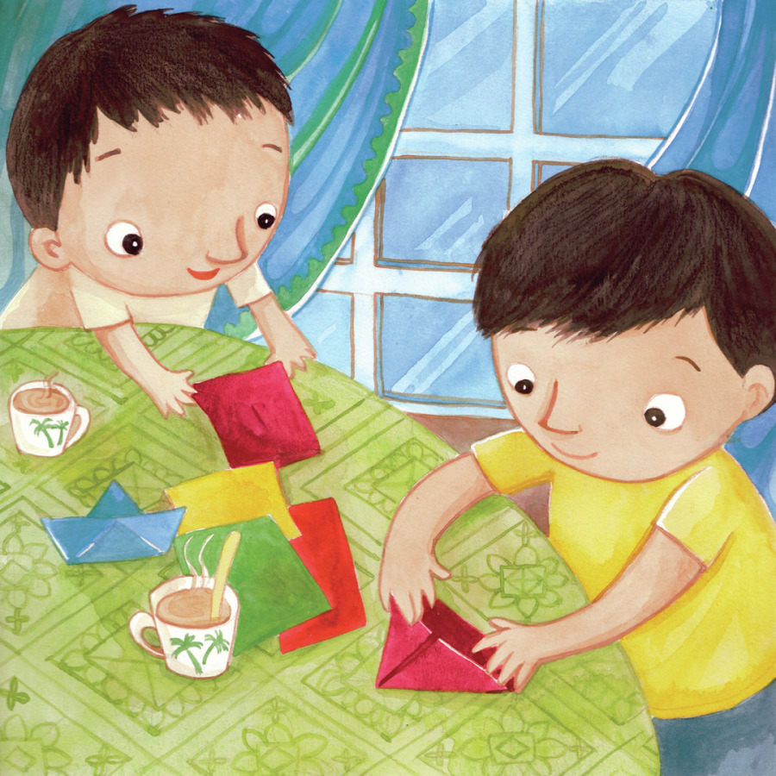
making paper planes
making a boat

Slide 16
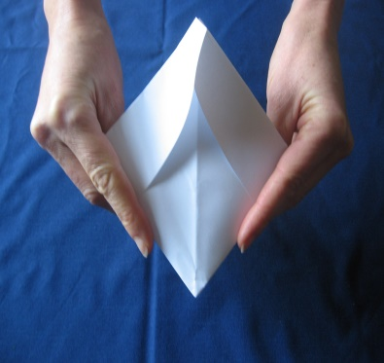
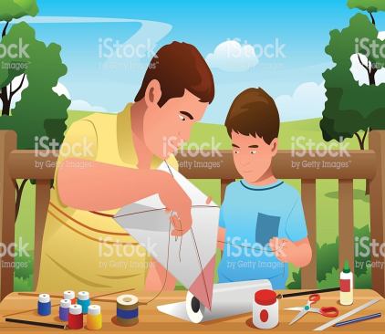

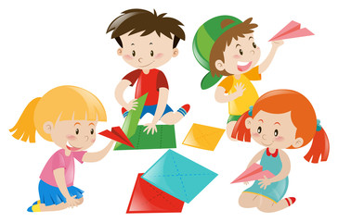

Bees find pictures
1
2
3
4
5
painting masks
making paper planes
making a pupet
making a boat
making a kite

Slide 17
New words
painting masks: đang tô những chiếc mặt nạ
making a puppet : đang làm 1con rối
making a paper boat : đang làm 1con thuyền giấy
making paper planes: đang làm những chiếc máy bay giấy

Slide 18
Model sentences
A: What are they doing ?
B:They’re drawing pictures.
They are drawing pictures.
B:They’re draw pictures.

Slide 19
Model sentences
A: What are they doing ?
Họ đang làm gì ?
B:They’re drawing pictures.
They are _____________
Họ đang vẽ những bức tranh.

Slide 20
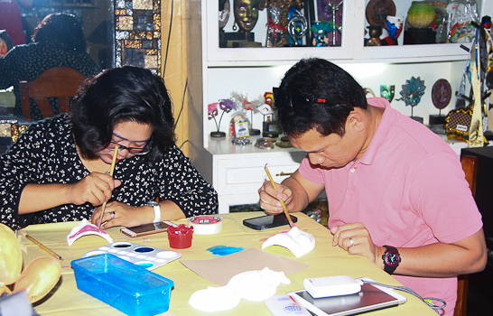
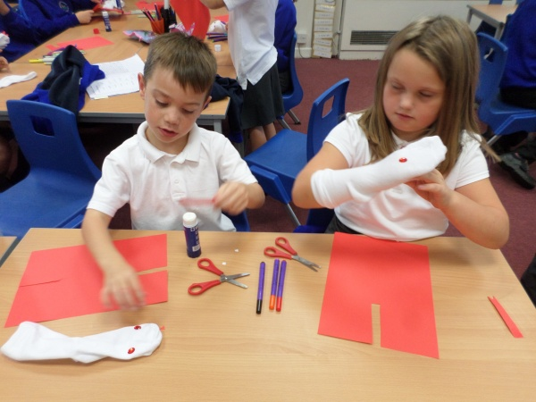
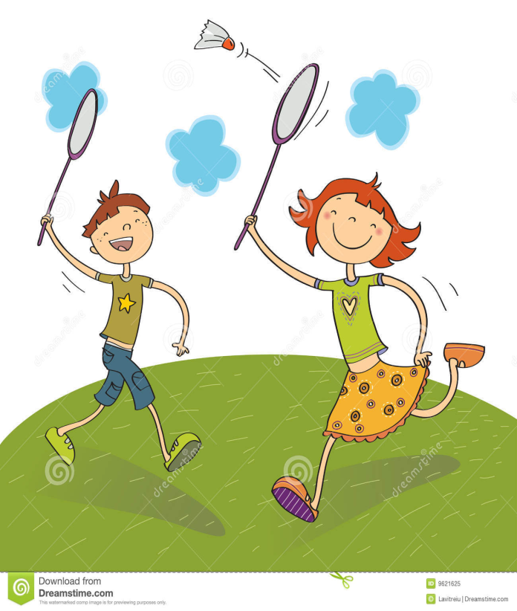

2. Point and say
A: What are they doing ?
B: They’re ______________
They are _____________

Slide 21

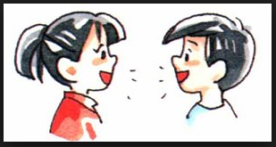
3.
A: What is he doing ? B:He’s _____________
A: What is she doing ? B:She’s ____________
A: What are they doing ? B: They’re _________

Slide 22

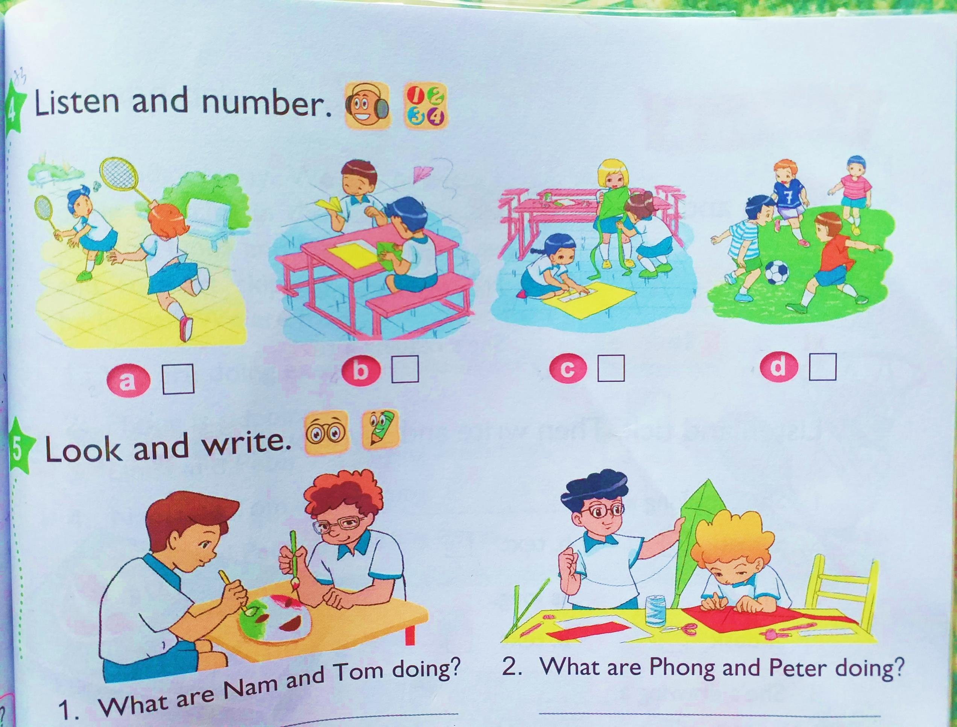
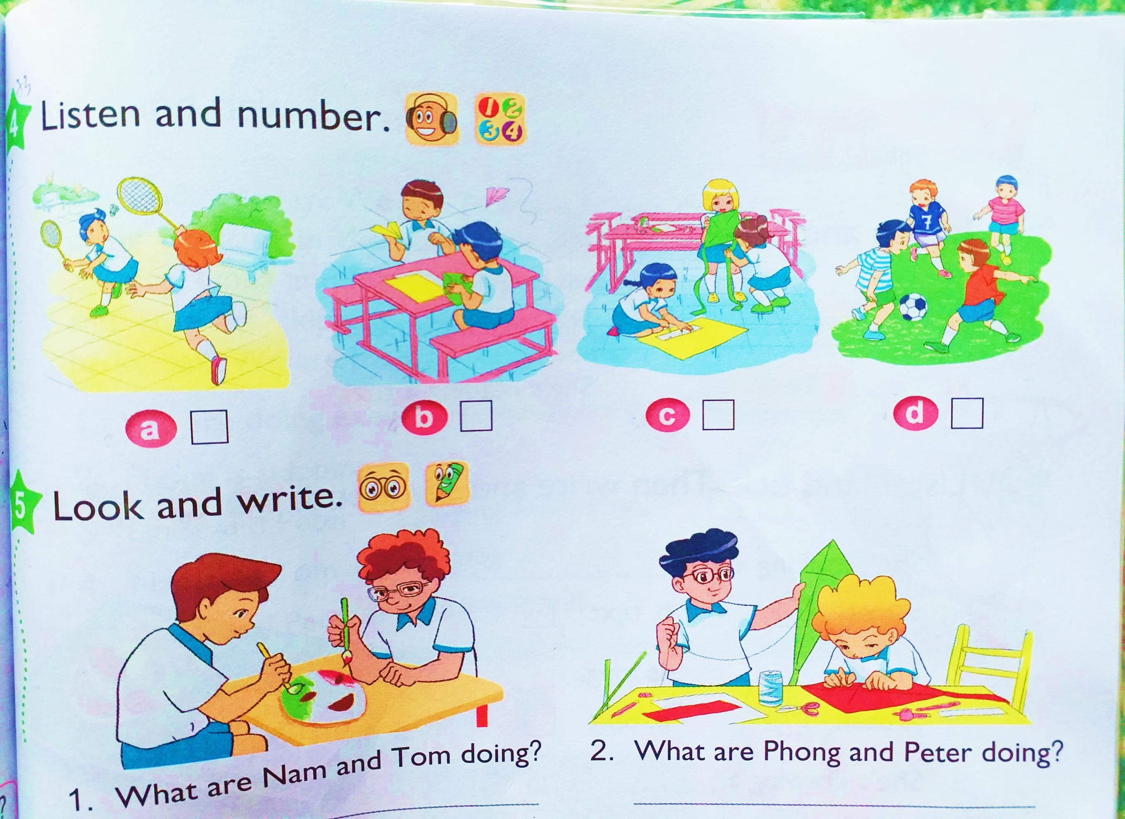
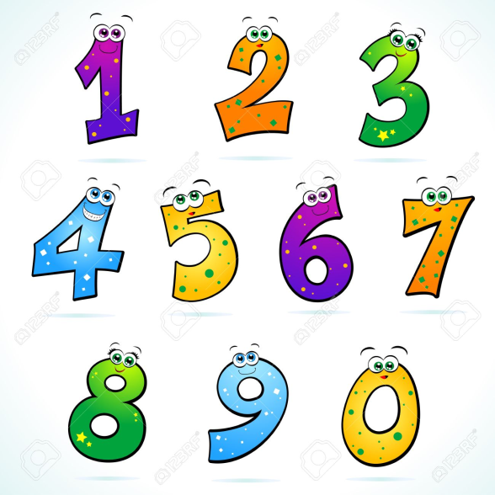
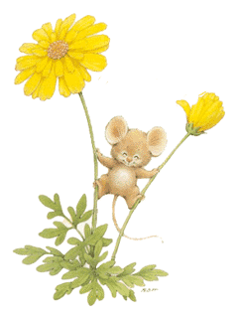

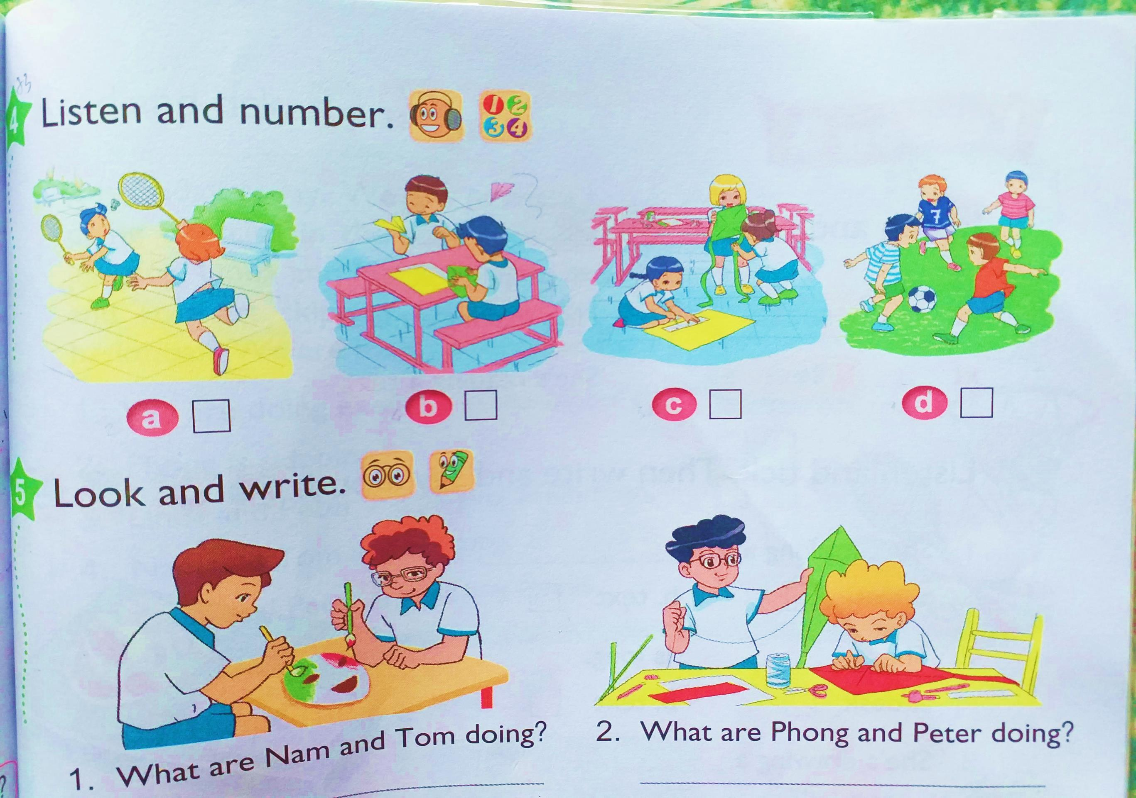



4.Listen and number

Slide 23

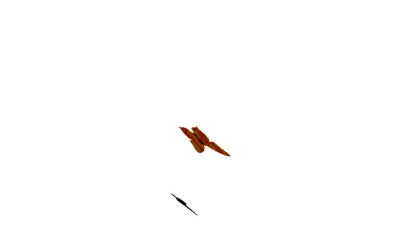
THANK YOU AND GOODBYE
See you again !

